Slide 1
https://www.onlinecjc.ca/article/S0828-282X(20)30300-7/fulltext
Precautions and Procedures for Coronary and Structural Cardiac Interventions during
the COVID-19 Pandemic: Guidance from CAIC-ACCI
DA Wood et al. Canadian Journal of Cardiology. Epub ahead of print. March 23, 2020

Slide 2
Agenda
Introduction 5 mins David A Wood MD
Ethical Framework 5 mins Eric A Cohen MD
STEMI/Cardiogenic Shock/OHCA 5 mins Kevin R Bainey MD
Other ACS, Type 2 MI, and Outpatients 5 mins Andrea Lavoie MD
CHIP and CTO 5 mins Hung Q Ly MD
Structural Procedures 5 mins Robert H Boone MD
Additional Considerations 5 mins Ata-ur-Rehman Quraishi MD
Questions 25 mins David Wood, Samer Mansour & Warren Cantor MD

Slide 3
COVID-19 & the Cardiovascular Patient
Practical advice for implementing recommendations
from the CCS COVID-19 Rapid Response Team
March 25th, 2020
Dr. Andrew Krahn, Vancouver, BC
Dr. David Wood, Vancouver, BC
Dr. Howard Leong-Poi, Toronto, ON
Dr. Shelley Zieroth, Winnipeg, MB
Dr. David Bewick, Saint John, NB
Dr. Anil Gupta, Mississauga, ON
Dr. Arsène Basmadjan, Montreal, QC
Dr. Bernard Cantin, Quebec, QC
Dr. Peter Guerra, Montreal, QC
Dr. Samer Mansour, Montreal, QC
Dr. Lawrence Rudski, Montreal, QC
Dr. Mark Liszkowski, Montreal, QC
La COVID-19 et le patient atteint d’une maladie cardiovasculaire
Conseils pratiques pour la mise en œuvre des recommandations
du Groupe de travail sur la réaction rapide à la COVID-19

Slide 4
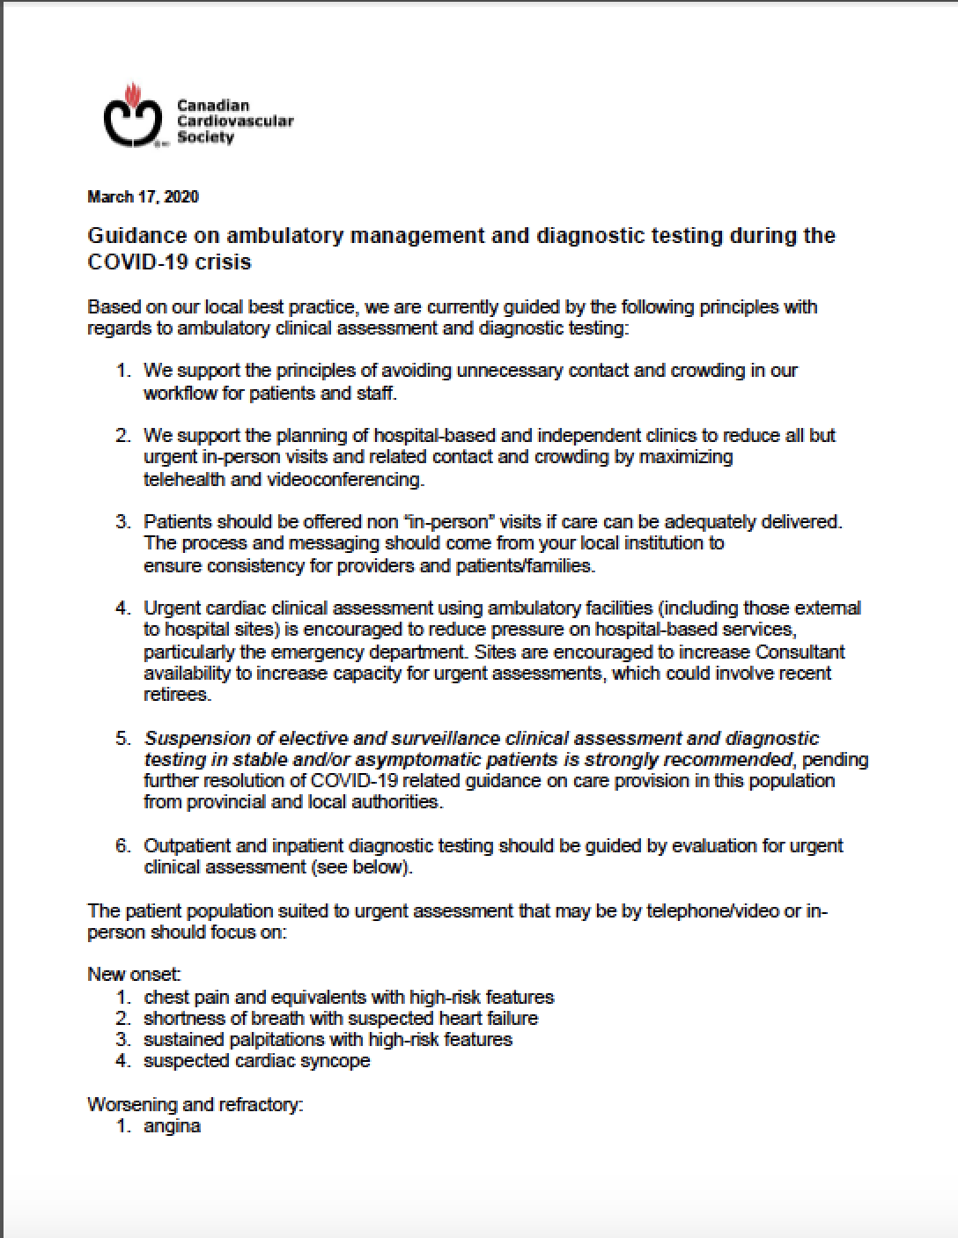
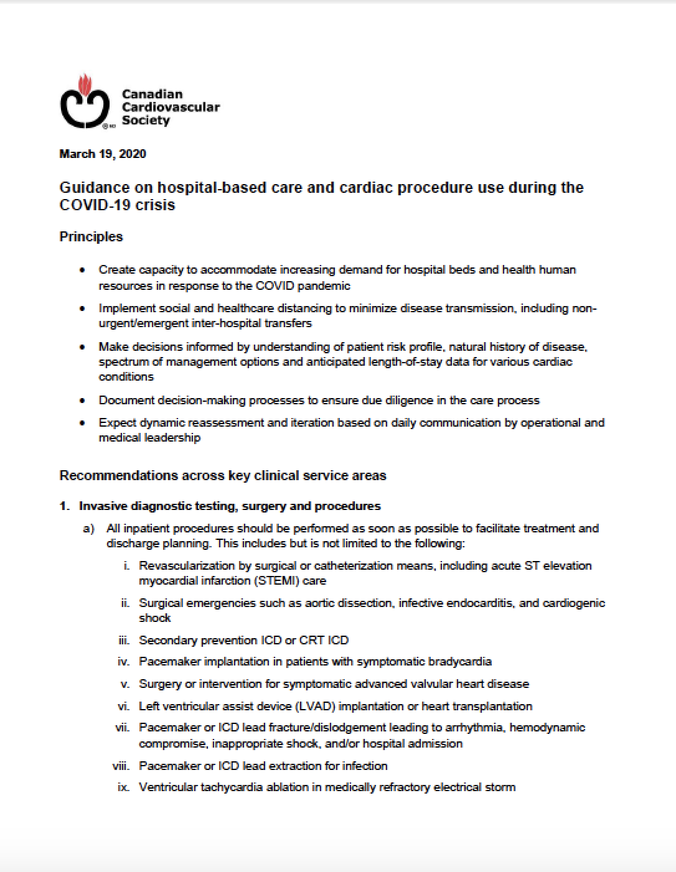
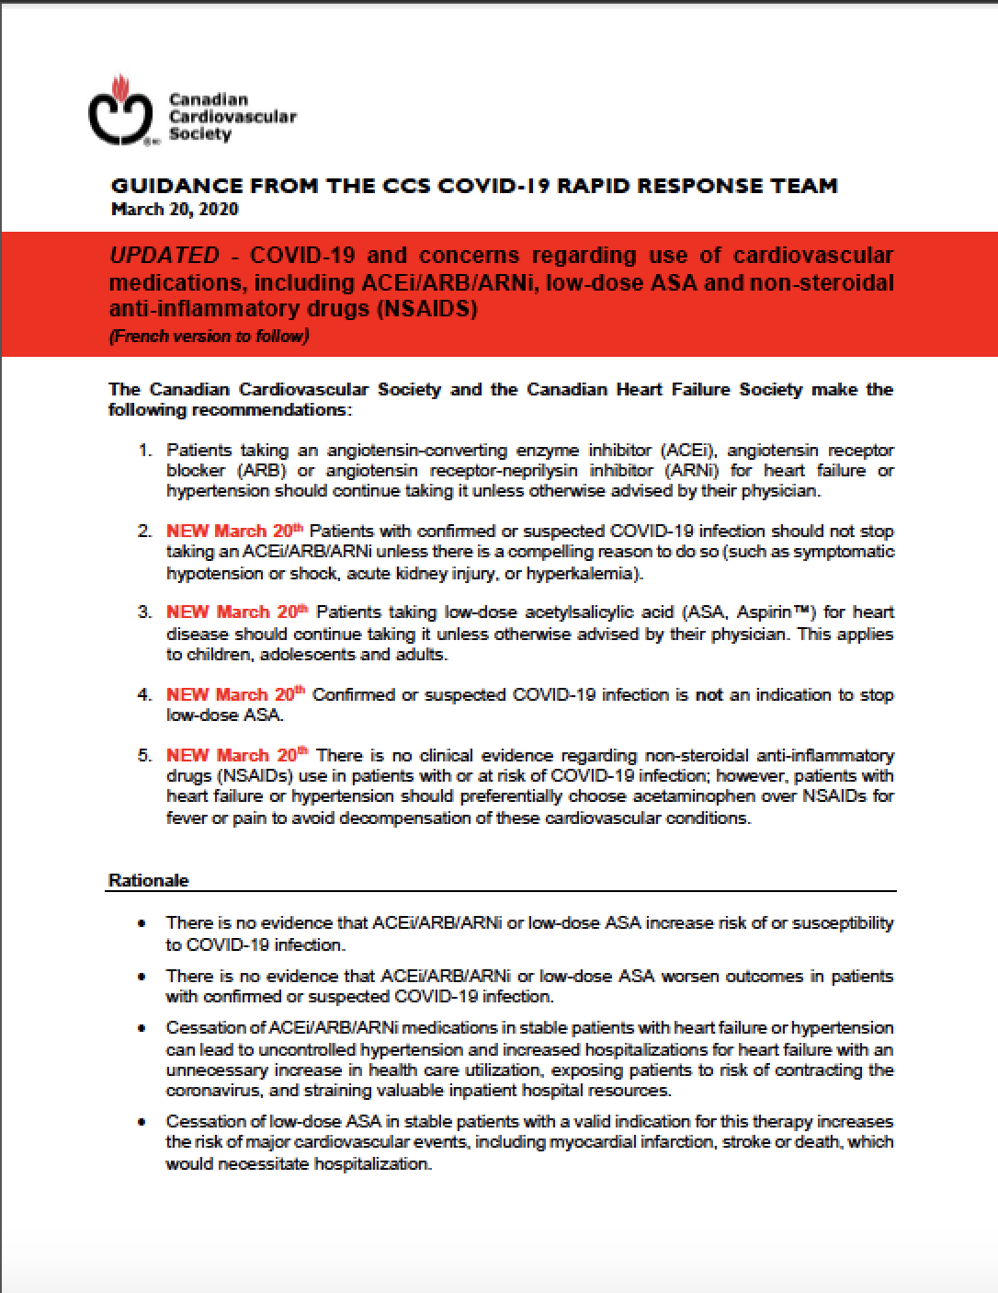
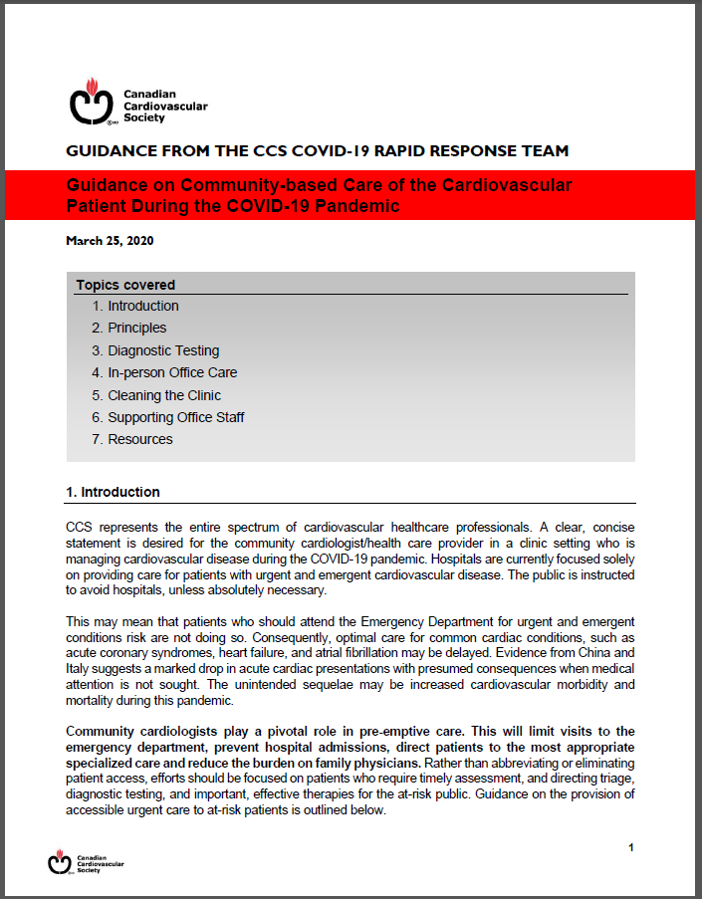
CCS COVID-19 Rapid Response Team – Guidance Documents
pdfs available on the CCS homepage www.ccs.ca
Ambulatory & Diagnostic
Medications
COVID & the Clinician
Hospitals & Procedures
NEW! Community-based Care
GUIDANCE FROM THE CCS COVID-19 RAPID RESPONSE TEAM

Slide 5
David A. Wood
MD, FRCPC, FACC, FESC
Vancouver, BC, Canada
President of CAIC-ACCI
Professor of Medicine, University of British Columbia
Director of the Centre for Cardiovascular Innovation and the VGH Cardiac Catheterization Laboratory
Incoming Division Head, VGH and UBC Hospital
GUIDANCE FROM THE CCS COVID-19 RAPID RESPONSE TEAM

Slide 6
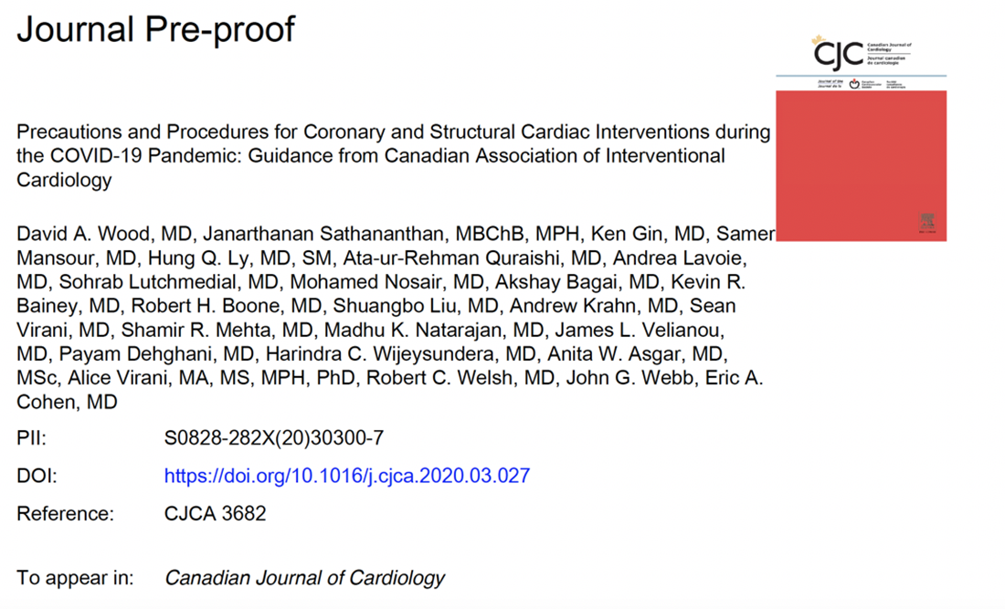
Precautions and Procedures for Coronary and Structural Cardiac Interventions during
the COVID-19 Pandemic:
Guidance from CAIC-ACCI
DA Wood et al. Canadian Journal of Cardiology.
Epub ahead of print. March 23, 2020
GUIDANCE FROM THE CCS COVID-19 RAPID RESPONSE TEAM

Slide 7
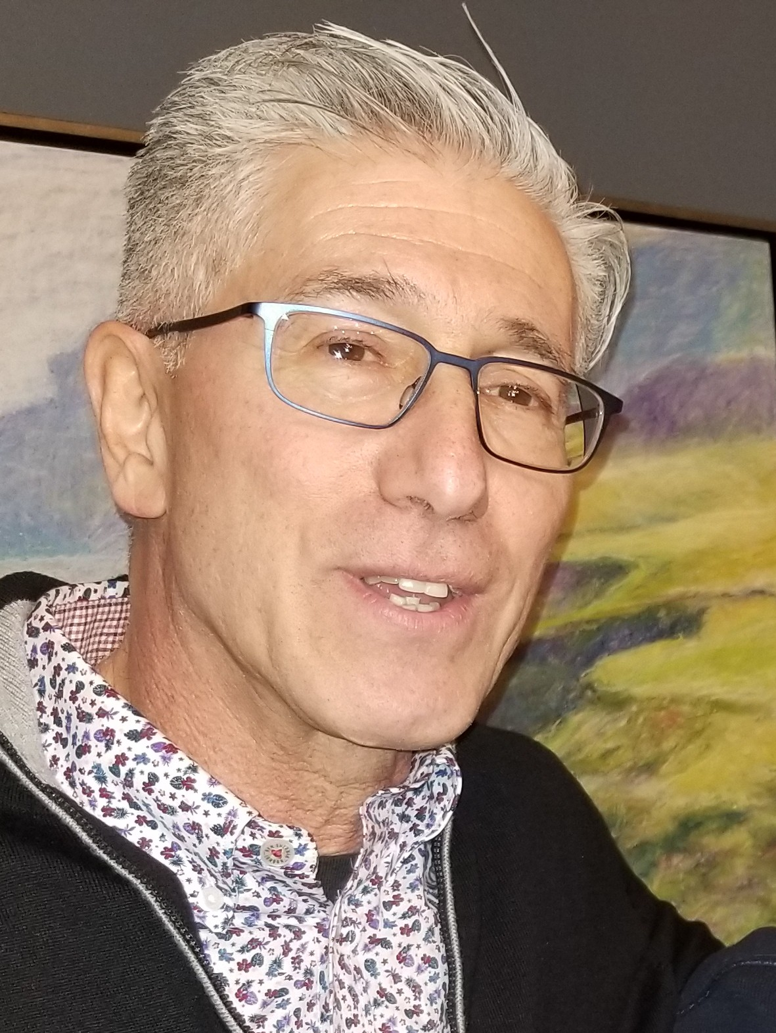
Ethical Framework Eric A Cohen MD

Slide 8
Ethical Framework
Limit cardiac use of overall system capacity, especially in-patient/ICU bed
(Working together, proportionality)
Minimize risk to healthcare workers
(Reciprocity, care provider safety, and sustainability)
Maximize preservation of personal protective equipment
(Preservation of resource)
Maximize compliance with social and healthcare distancing
(The harm principle)
Minimize the incremental risk of patients acquiring COVID-19 related to cardiac investigations or procedures
(The harm principle, proportionality)
Maintain essential interventional cardiology service to patients at high risk of cardiovascular events in the short term
(Preservation of resources)
Minimize adverse outcomes for cardiovascular patients during the COVID-19 pandemic
(The harm principle)
Ensure decisions are made in a consistent manner
(Procedural justice, accountability, reasonableness)
Ensure decisions are documented and communicated transparently and sensitively
(Respect and transparency)

Slide 9
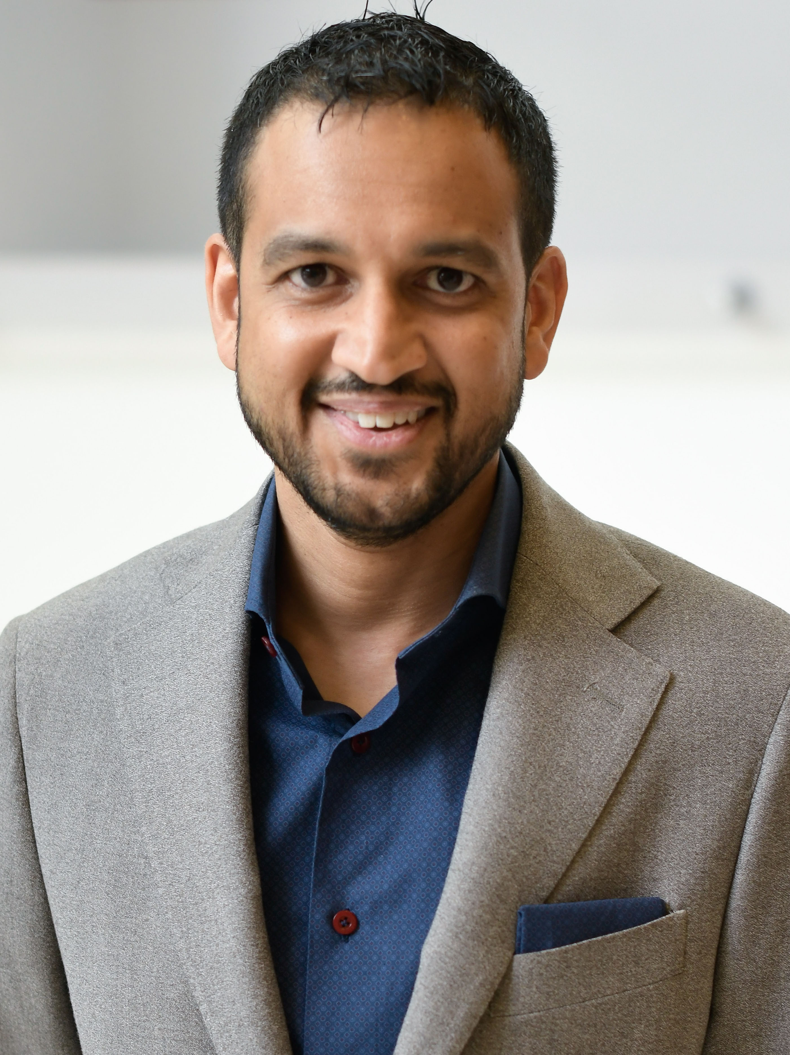
STEMI/Cardiogenic Shock/OHCA Kevin R Bainey MD

Slide 10
Table 1: CAIC-ACCI Guidance for the Management of Coronary and Structural Procedures as COVID-19 Escalates and Abates
CORONARY
Response
Levels
1
2
3
Minor restriction in
regular services
Major restriction in
regular services
Complete inability to
provide services due to
staff/resource limitations
STEMI
Cardiogenc
Shock
Out of
Hospital
Cardiac
Arrest
(OHCA)
Patients with low probability of COVID-19 – PPCI OR pharmacoinvasive as per current regional practice.
Patients with Moderate/High probability or COVID-19 +ve - PPCI with Aerosol Level PPE and N95 mask OR pharmacoinvasive at discretion of the treating team. If pharmacoinvasive with successful fibrinolysis, consider emergent COVID-19 testing with planned PCI within 24hrs.
Patients with low probability of COVID-19 – Continue as per usual regional practice.
Patients with Moderate/High probability or COVID-19 +ve -Consider an invasive approach with Aerosol Level PPE and N95 mask if age OR comorbidities do not preclude a reasonable likelihood of meaningful survival.
Patients with low probability of COVID-19 – Continue as per usual regional practice.
Patients with Moderate/High probability or COVID-19 +ve -Consider an invasive approach with Aerosol Level PPE and N95 mask if age OR comorbidities do not preclude a reasonable likelihood of meaningful survival.
Patients with low probability of COVID-19 – PPCI OR pharmacoinvasive as per current regional practice. Patients with Moderate/High probability or COVID-19 +ve - PPCI with Aerosol Level PPE and N95 mask OR pharmacoinvasive at discretion of the treating team. If pharmacoinvasive with successful fibrinolysis, consider emergent COVID-19 testing with planned PCI within 24hrs.
Patients with low probability of COVID-19 – Continue as per usual regional practice. Patients with Moderate/High probability or COVID-19 +ve - Consider an invasive approach with Aerosol Level PPE and N95 mask if age OR comorbidities do not preclude a reasonable likelihood of meaningful survival.
Most patients now considered Moderate/High probability or COVID-19 +ve - Consider an invasive approach with Aerosol Level PPE and N95 mask if age OR comorbidities do not preclude a reasonable likelihood of meaningful survival.
Complete inability to provide PPCI. All patients will be treated with Thrombolysis as per regional protocols.
Medical management of all cardiogenic shock cases.
Medical management of all OHCA

Slide 11
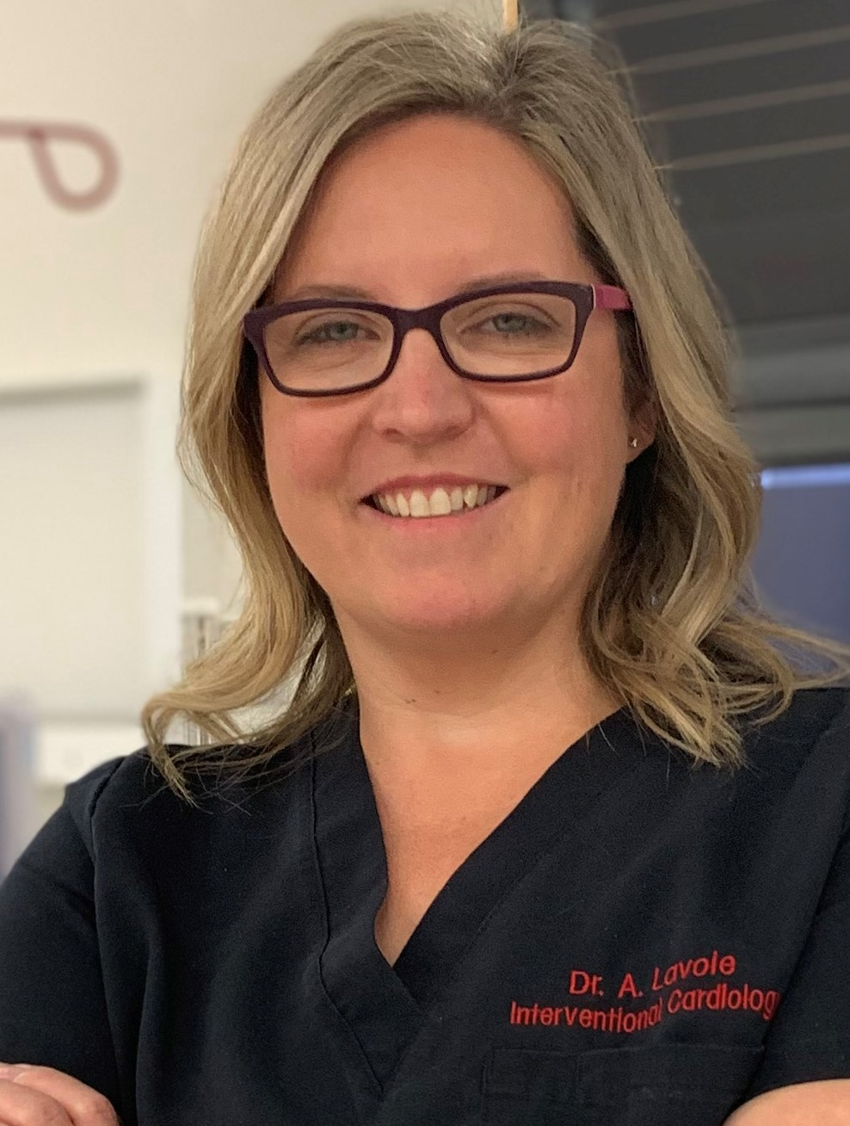
Other ACS, Type 2 MI, and Outpatients Andrea Lavoie MD

Slide 12
Response
Levels
1
2
3
Minor restriction in
regular services
Major restriction in
regular services
Complete inability to
provide services due to
staff/resource limitations
NSTEMI (High Risk)
(Refractory symptoms,
hemodynamic
instability, significant LV dysfunction,
suspected LM or significant proximal
Epicardial disease,
GRACE risk score >140)
Low/Medium Risk NSTEMI and UA
Type 2 MI (Consider
COVID-19 myocarditis)
Outpatients
Patients with low probability of COVID-19 – Invasive approach as per current regional practice.
Patients with Moderate/High probability of COVID-19 - Invasive approach with Aerosol Level PPE and N95 mask.
COVID-19 +ve – consider invasive strategy with Aerosol Level PPE and N95 mask.
Invasive approach OR medical management for most patients. If medical management selected and failed, screen (symptom questionnaire AND swab) all patients for COVID-19 prior to invasive approach. If COVID-19 +ve, Aerosol Level PPE and N95 mask.
Investigations and treatment as per clinical judgement. Consider CT coronary angiography with Droplet Level PPE instead of an invasive approach.
Consider cardiac catheterization for outpatients who are clinically considered to be moderate to higher risk.
Screen (symptom questionnaire AND/OR swab) all patients for COVID-19.
All non-urgent/elective cases should be deferred for > 30 days.
Most patients now considered Moderate/High probability or COVID-19 +ve - Consider an invasive approach with Aerosol Level PPE and N95 mask.
Medical management favored over an invasive approach for most patients. If medical management selected and failed, screen (symptom questionnaire AND swab) all patients for COVID-19 prior to invasive approach. If COVID-19 +ve, Aerosol Level PPE and N95 mask.
Investigations and treatment as per clinical judgement. Consider CT coronary angiography with Droplet Level PPE instead of an invasive approach.
Consider cardiac catheterization for “urgent” outpatients only including those with symptoms AND non-invasive testing suggesting high risk for CV events in the short term.
Screen (symptom questionnaire AND/OR swab) all patients for COVID-19.
Others should be considered lower-risk and deferred for >30 days
Medical management of all ACS
Medical management of all ACS
Medical management of all Type 2 MI
Medical management for all Outpatients

Slide 13
CHIP and CTO Hung Q Ly MD

Slide 14
Response
Levels
1
2
3
Minor restriction in
regular services
Major restriction in
regular services
Complete inability to
provide services due to
staff/resource limitations
CHIP
CTO
Limited cases that would facilitate hospital discharge.
Screen (symptoms questionnaire AND swab) all
patients for COVID-19.
Complete cessation of cases
Complete cessation of cases
Complete cessation of cases
Complete cessation of cases
Complete cessation of cases

Slide 15
Structural Procedures Robert H Boone MD

Slide 16
STRUCTURAL HEART
Response
Levels
1
2
3
Minor restriction in
regular services
Major restriction in
regular services
Complete inability to
provide services due to
staff/resource limitations
TAVI
MitraClip
Myocardial
Biopsies
ASD/PFO
LAAC
Adult Congenital
Pre-Solid
Organ
Transplant
Pulmonary
HTN
High risk TAVI cases only with short expected LOS (low EF, valve-in-valve with severe AR, or recent hospitalization).
High risk cases with history of repeated HF hospitalizations or ER visits
Limited cases in collaboration with Transplant Team
Complete cessation of cases
Complete cessation of cases
Limited cases in collaboration with Adult Congenital Team
Complete cessation of cases
Limited cases in collaboration with Pulmonary Hypertension Team
Limited inpatient cases that would facilitate hospital discharge
Limited inpatient cases that would facilitate hospital discharge
Limited cases in collaboration with Transplant Team
Complete cessation of cases
Complete cessation of cases
Complete cessation of cases
Complete cessation of cases
Complete cessation of cases
Complete cessation of cases
Complete cessation of cases
Complete cessation of cases
Complete cessation of cases
Complete cessation of cases
Complete cessation of cases
Complete cessation of cases
Complete cessation of cases

Slide 17
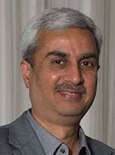
Additional Considerations Ata-ur-Rehman Quraishi MD

Slide 18
Additional Considerations
We encourage all Canadian research teams to carefully track cardiovascular outcomes in the coming months, and focus on key research gaps recently identified. If we document a large increase in potentially avoidable cardiac deaths from unavailable procedures, then difficult but necessary discussions about allocation of resources to infection vs. emergent cardiovascular procedures will be crucial.
Certain cardiac catheterization staff with co morbidities associated with adverse events in the setting of contracting COVID-19 (age 60 years, diabetes, hypertension, or pre-existing cardiovascular disease) may wish to refrain from procedures with an increased risk of aerosolization if adequate PPE cannot be provided. Depending on their level of competency and in accordance with their training programs, trainees may also wish to refrain from all cardiac catheterization procedures.
PPE use, including correct donning and doffing, changing scrubs and showering between cases with a high likelihood of COVID-19, and changing civilian clothes and footwear upon entering and leaving the hospital will remain our best defence during the pandemic.

Slide 19
Additional Considerations
The threshold for performing percutaneous vs surgical coronary and valvular interventions may vary as the pandemic escalates and abates. After review by the Heart Team, multivessel PCI, TAVI or MitralClip may be appropriate to facilitate hospital discharge and reduce length of stay (LOS);
In the setting of STEMI (or other situations requiring emergent cardiac catheterization), pre-hospital screening for symptoms of influenza like illnesses (ILI), pre-existing knowledge of COVID-19 positivity, and if available in the future, rapid COVID-19 testing should be strongly encouraged so that patients can receive appropriate care and by-pass the emergency department;
Goal of rapid but safe discharge with teleconference or telephone follow-up should be promoted to facilitate bed capacity and avoid hospital exposure.

Slide 20
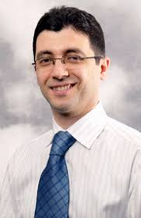
Questions/Comments David A Wood MD, Samer Mansour MD & Warren Cantor MD
Appreciating how many clinicians are participating, please send a personal message at the bottom of your GoToMeeting screen to Kevin McKenzie indicating you have a question. The floor will be opened to individuals in the sequence received.

Slide 21
We hope everyone is safe and healthy and this is all a distant memory when we meet in Vancouver next Spring!
Save the Date!
April 16th & 17th, 2021
Vancouver, BC, Canada

Slide 22
Precautions and Procedures for Coronary and Structural Cardiac Interventions during
the COVID-19 Pandemic:
Guidance from CAIC-ACCI
DA Wood et al. Canadian Journal of Cardiology.
Epub ahead of print. March 23, 2020
GUIDANCE FROM THE CCS COVID-19 RAPID RESPONSE TEAM

