Slide 1
Complex Atherectomy with Impella Support
Will Shockwave Replace Rotational Atherectomy or Are These Complementary Technologies?
Basem Elbarouni
University of Manitoba

Slide 2
73 F presented to ER with recurrent chest pains and palpitations. Found to have paroxysmal afib. Positive troponin
Discharged on Metoprolol and Apixaban referred to Adult Medicine clinic
Complaining of recurrent exertional chest pain on exertion, relieved with nitro
Referred for coronary angiography

Slide 7
CABG? +/-viability?
PCI?
Medical management?

Slide 8
Patient frail, independent
CvSx consulted, viability requested
MRI done. EF 40%. No viability in middle to distal anterior wall and apex
Not a surgical candidate

Slide 9
Multiple long discussions with patient. Reluctant to proceed with CHIP
Opted for medical management with clinical follow up
In clinic angina reasonably controlled, opted to wait
Then called my clinic asking for procedure date

Slide 21
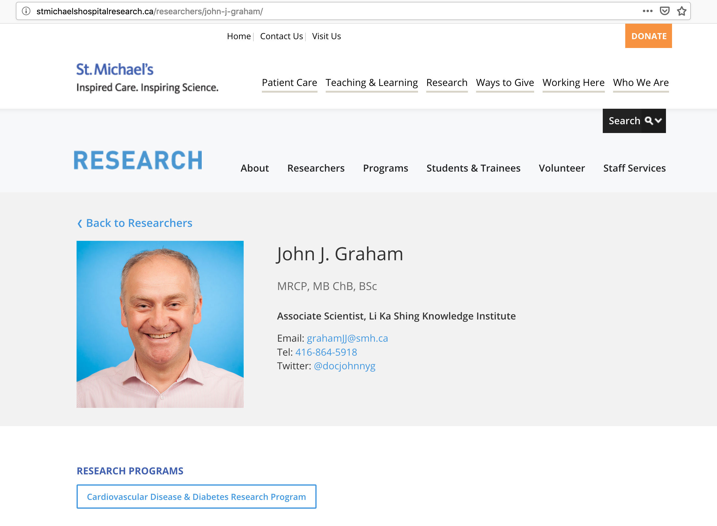

Slide 22
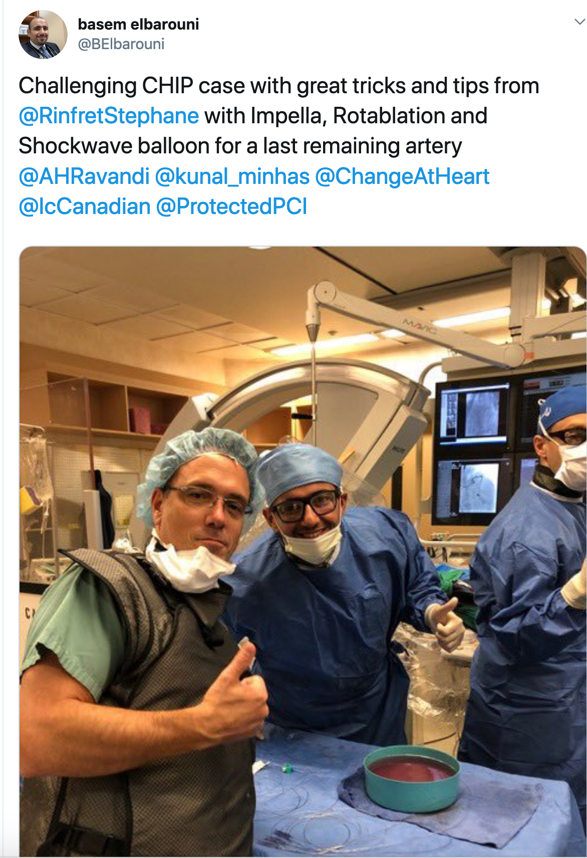
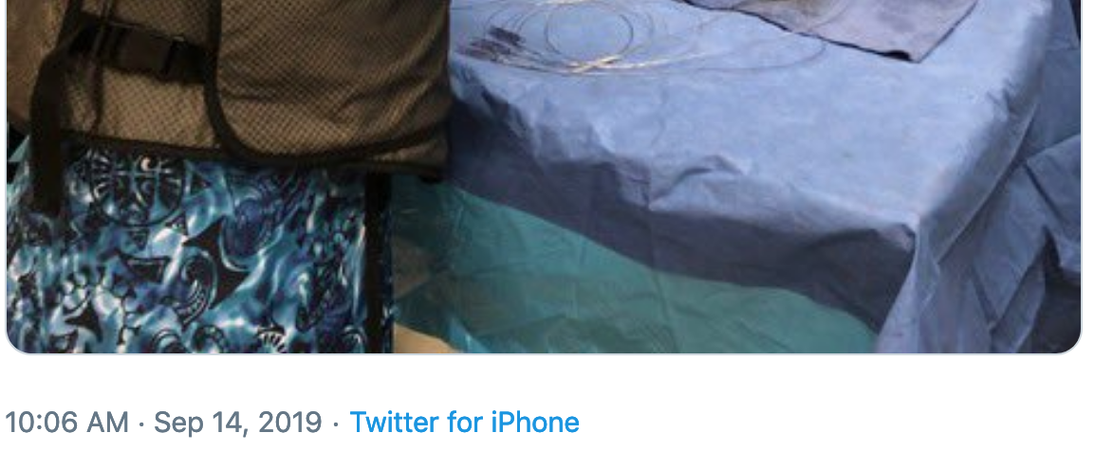

Slide 23
Conclusion
Impella allows us to perform CHIP and obtain good results without worrying about hemodynamic compromise
Shockwave is a great new tool that allows us to obtain full expansion in heavily calcified lesions
Rotablation and Shockwave are complementary technologies

