Slide 1

Prolonged Dual Antiplatelet Therapy Versus Dual Pathway Inhibition Debate
Alexis Matteau, MD, MSc, FRCPC
Cardiologist, CHUM
CHUM Research Center
Clinical Assistant Professor, Université de Montréal
alexis.matteau@umontreal.ca

Slide 2
Disclosures
Conferences: AstraZeneca, Merck

Slide 3
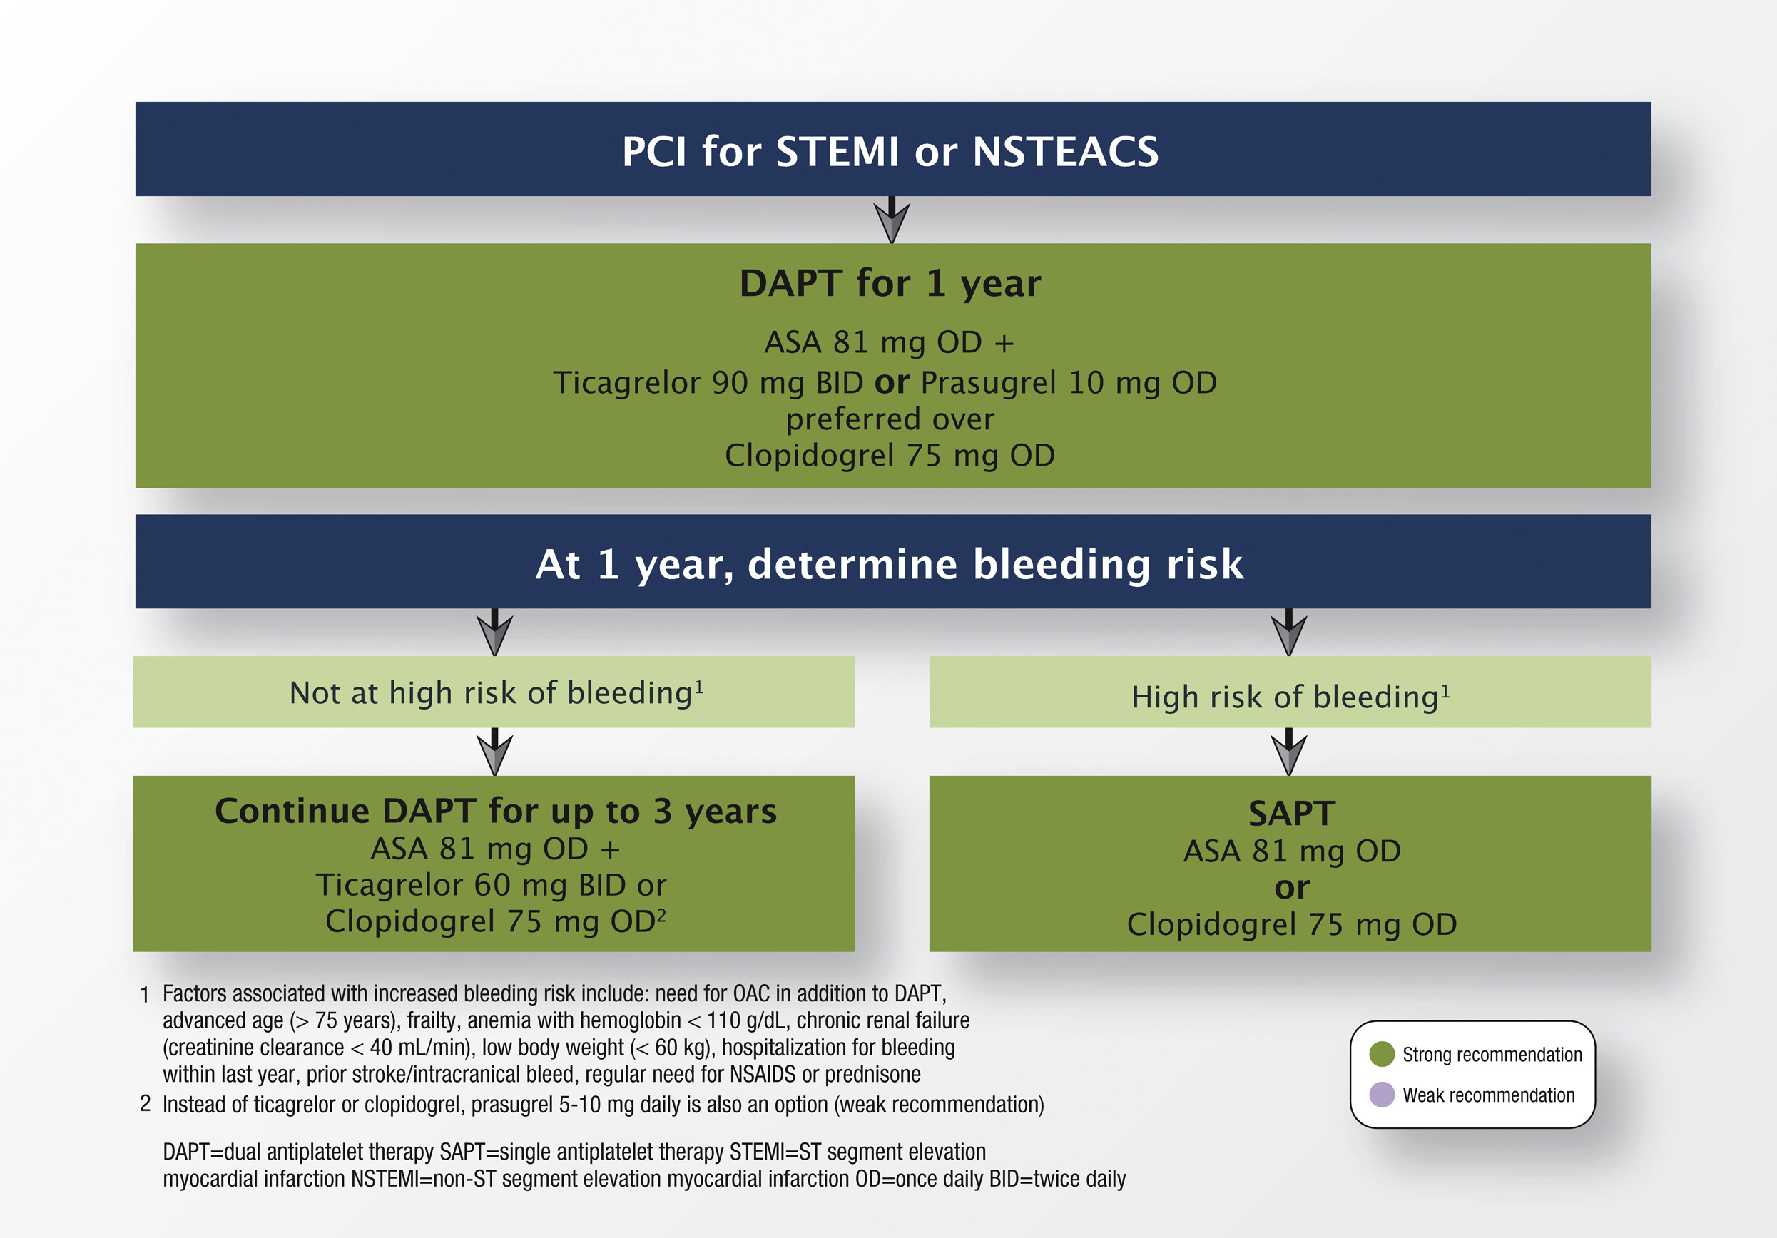
2018 CCS/CAIC Focused Update on the Guidelines for the Use of Antiplatelet Therapy
Can J Cardiol 2018

Slide 4
Then what…
Good old days, life was simple:
  DAPT stopped after 1 year and low-dose ASA kept long-term
In recent years:
Stop ADP antagonist and keep ASA only
Keep DAPT long-term (up to 3 years)
Switch ADP antagonist for low-dose antithrombotic agent

Slide 5
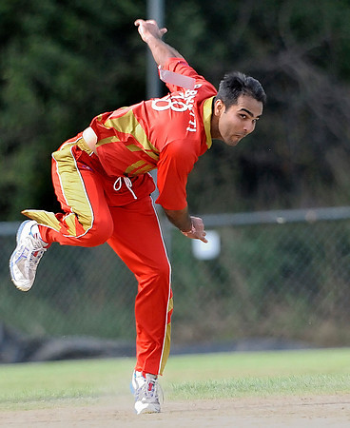
And the substudies

Slide 6
What is the evidence for prolonged DAPT?
Randomized trials
  Secondary prevention at large
    Clopidogrel: CHARSIMA Trial
    Ticagrelor: PEGASUS – TIMI 54
  DAPT duration after PCI
    Many smaller-sized studies
    DAPT trial
Substudies
Meta-analyses

Slide 7
CHARISMA trial
15603 patients (78% established CVD, 22% RF only)
Low-dose ASA versus DAPT clopidogrel (median 28 months)
Neutral results overall but potential benefits in pts with CVD:
N Engl J Med 2006, J Am Coll Cardiol 2007

Slide 8
DAPT duration after PCI
 | Year | N | Population | ACS | Duration (mo)
EXCELLENT | 2012 | 1443 | 100% DES | 50% | 6 vs 12
PRODIGY | 2012 | 1501 | 25% BMS 25% zota/25%pacli/25% evero | 75% | 6 vs 24
RESET | 2012 | 2117 | 50% zota 50% other DES | 55% | 3 vs 12
OPTIMIZE | 2013 | 3119 | 100% zotarolimus | 40% | 3 vs 12
DES-LATE | 2013 | 5045 | 100% DES | 60% | 12 vs 36
SECURITY | 2014 | 1399 | 100% DES | 40% (AI) | 6 vs 12
ITALIC | 2014 | 1894 | 100%DES | 25% | 6 vs 12
ISAR-SAFE | 2014 | 4000 | 100% DES | 40% | 6 vs 12
ARCTIC-INTERRUPTION | 2014 | 1259 | 100% DES | 25% | 12 vs 18-24
DAPT | 2014 | 9961 | 100% DES | 40% | 12 vs 30

Slide 9

DAPT Study
22866 patients enrolled after receiving a DES
  9961 patients randomized at 12 months (ASA versus DAPT)
Reduction of:
  Stent thrombosis (Def/Prob) by 71%
  MI by 53%
No change for
  Stroke
  CV death
Increase of
  Non-CV death (HR 2.23)
  GUSTO mod/severe bleeding (HR 1.61)
N Engl J Med 2014

Slide 10
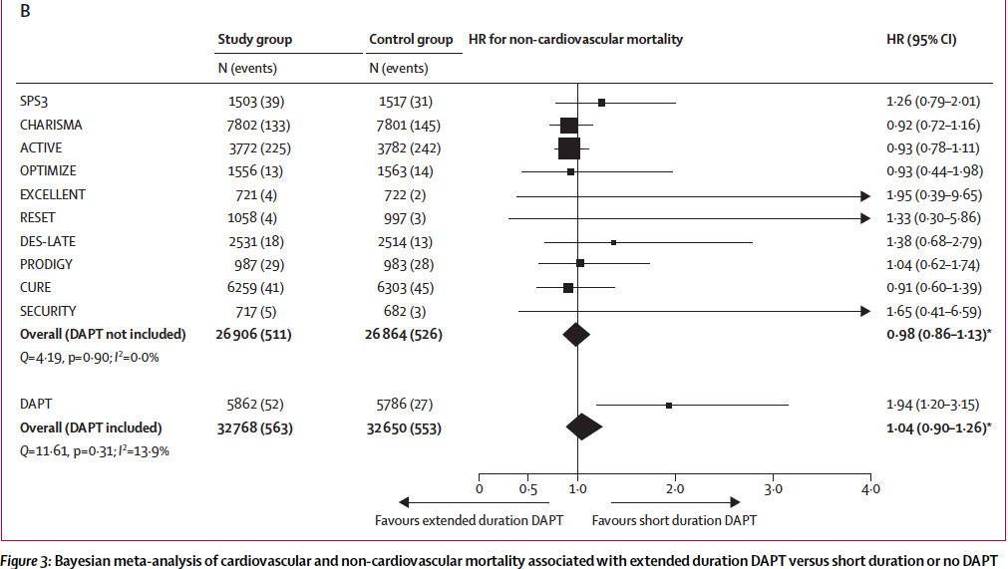
Increase in non-CV mortality with DAPT???
More cancer patients at baseline in DAPT group despite randomization in DAPT Study
Lancet 2015

Slide 11
Pegasus – TIMI 54
21162 patients with MI 1-3 years before enrollment
Greater benefits if P2Y12 inh not stopped at 1 yr!
Reduction of:
  MI by 16%
  Stroke by 25%
No change for
  CV death (H 0.83 [0.68-1.01])
Increase of
  TIMI major bleeding (HR 2.32)
N Engl J Med 2015, Eur Heart J 2016

Slide 12
COMPASS Study
27395 patients with CAD and/or PVD
Randomized to:
  ASA versus ASA+Riva 2.5 mg bid versus Rivaroxaban 5 mg bid
Reduction of:
  CV death/MI/stroke by 24%
  CV death by 22%
  Stroke by 42%
No change for
  MI
Increase of
  Major bleeding (HR 1.51)
N Engl J Med 2017

Slide 13
Are we comparing apples and oranges?
Population in COMPASS at much higher risk
  CAD = multivessel disease/PCI/CABG or MI within last 20 years
  Patients < 65 y.o. needed either ASD in > 2 vascular beds or 2 risk factors
DAPT Study
  > 18 y.o., PCI and without events at 12 months
PEGASUS-TIMI 54
  MI 1-3 years with patients < 65 y.o. needed 1 risk factor
 | DAPT study | PEGASUS-TIMI 54 | COMPASS
Mean age (years) | 61.6 | 65.3 | 68.2
Prior MI | 21.6 | 100 | 62.2
PVD | 5.8 | 5.4 | 27.2
Diabetes | 30.6 | 32.1 | 37.8

Slide 14
DAPT Study – MI presentation
Reduction of:
  MI by 58%
  Stent thrombosis by 73%
No change for
  Cardiac death (H 0.67 [0.31-1.44])
Increase of
  GUSTO mod/sev bleeding (HR 2.38)
J Am Coll Cardiol 2015

Slide 15
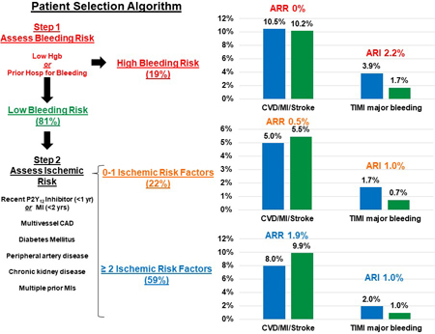
PEGASUS-TIMI 54 risk stratification
Including a reduction in CV mortality by 34%
AHA abstract 2018

Slide 16
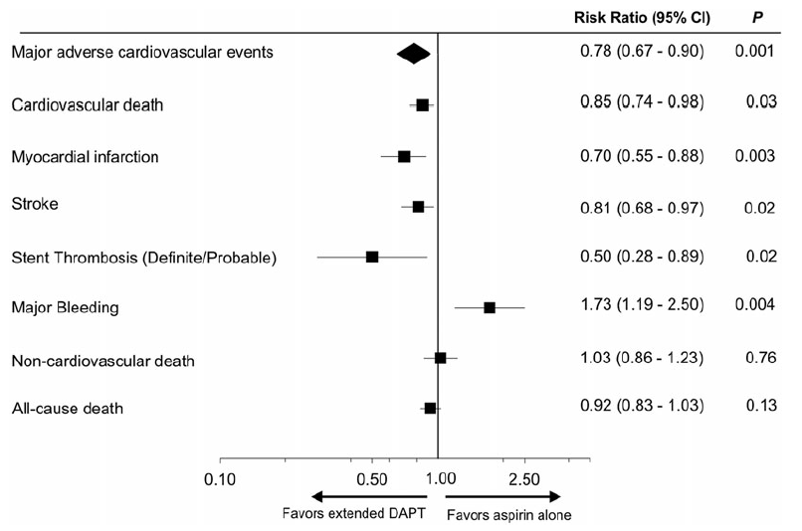
Long-term DAPT in patients with previous MI
Meta-analysis
6 RCTs
  CHARISMA MI
  PRODIGY
  ARTIC-Int
  DAPT
  DES-LATE
  PEGASUS-TIMI 54
Eur Heart J 2015
Notes:
Long-term DAPT offers a more complete cardiovascular protection

